Slide 1
MATLAB
Lab Four exercises
Curve Animation
Instructor: 黃世強 (Sai-Keung Wong)

Slide 2
About the demo video
A demo video may have bugs. The demo video shows roughly the results. These results may not be exactly the same as the requirements. They are for your own reference. You must follow the instruction to finish your programs.

Slide 3
Program file name format
Write all your programs in a folder. The folder name is your lab04_student_ID.
Zip the folder and upload it.
Write a program for each problem in one file.
The file name is lab04_X_yourStudentID.m, where X is the problem number.
For example, if your student ID is 12345678 and the problem number is 3, then the file name must be lab04_3_12345678.m.
Do not output all the intermediate results.
Output the results that are required only.

Slide 4
For each problem, display the problem number before showing the results.
clf; clear; clc; % clear the current figure
% clear variables, and clear screen
disp(‘Lab Problem 4.1’) % show Lab Problem 4.1

Slide 5
At the top of the file, write down your name, ID, email address, department, and date.
%%%%%%%%%%%%%%%%%%%%%%%%%%%
% Assignment Number: …
% Problem number: …
% Student Name: …
% Student ID: …
% Email address: …
% Department: Computer Science, NCTU
% Date: ….
%%%%%%%%%%%%%%%%%%%%%%%%%%%%

Slide 6
Problem 4.0. Example
Given two pairs of functions:
y1(x) = x, y2(x) = ( x² +2 )/ (|x|+1)
z1(x) = sin(x) + 1, z2(x) = cos(x)
Interpolate linearly the two functions of each pair.
e.g., y(x) = k y1(x) + (1-k) y2(x),
Animate the interpolation process by changing k from 1 to 0, with decrement 0.01. Pause for 1/30 second per step.
Show the result on the same figure. Each pair of functions is shown in a subregion. The original functions must also be plotted.
Beautify the figure. x in [-10, 10]

Slide 7
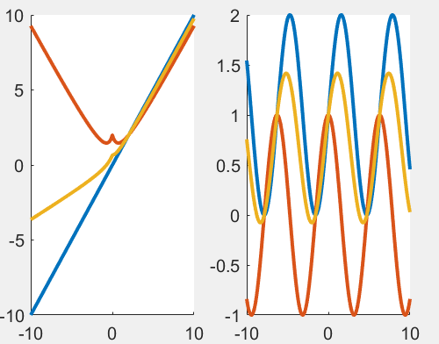
Problem 4.0. Example
Given two pairs of functions:
y1(x) = x, y2(x) = ( x² +2 )/ (|x|+1)
z1(x) = sin(x) + 1, z2(x) = cos(x)
Interpolate linearly the two functions of each pair.
e.g., y(x) = k y1(x) + (1-k) y2(x),

Slide 8
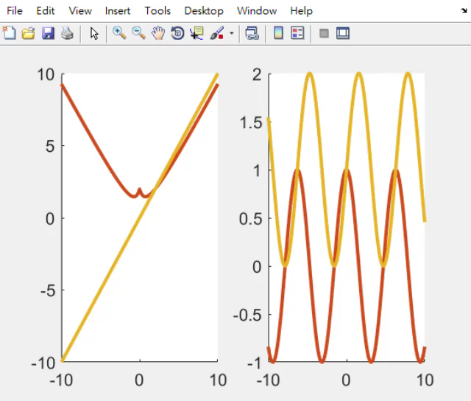
Problem 4.0. Example

Slide 9
(50%) Problem 4.1.
Given two functions
y1(x) = sin(5x) + 5, y2(x) = 2cos(x²) – 5
z1(x) = x*sin(x/2) + 5, z2(x) = 2cos(x²)/(sin(x)+1.5) - 1
Interpolate linearly the two functions of each pair.
e.g., y(x) = k y1(x) + (1-k) y2(x).
Animate the interpolation process by changing k from 1 to 0, with decrement 0.01. Pause for 1/30 second per step.
Show the result on the same figure. Each pair of functions is shown in a subregion. The original functions must also be plotted.
Set the font size properly. x in [-10, 10]

Slide 10
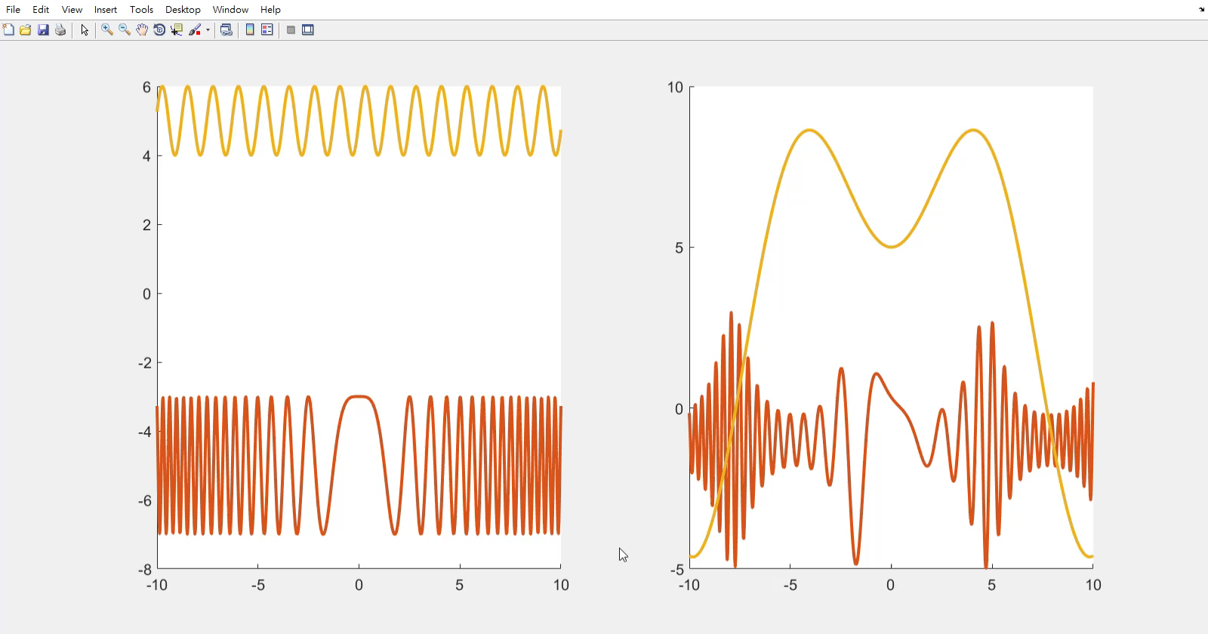
Problem 4.1.

Slide 11
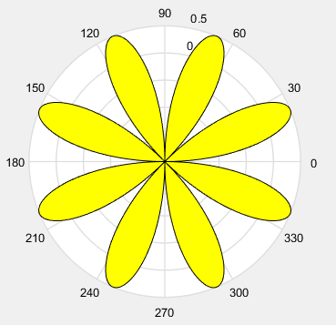
(50%) Problem 4.2.
x = 0:0.01:pi*2;
r = cos(2x)sin(2x);
The program draws a figure on the right.
Write a program to trace the curve by changing x in the interval. Fill the region(s) while the curve is being drawn.

Slide 12

Problem 4.2.

Slide 13
End
Enjoy MATLAB Programming.

